Slide 1


mmFace: 3D Face Recognition using RGB and Millimetre Wave Radar
Stergious Aji

Slide 2

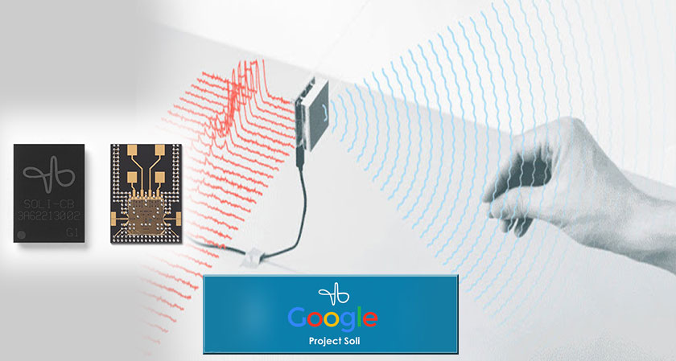
Motivations
Face recognition is a naturally accessible way of authenticating identity
Current systems like Apple’s Face ID employ NIR sensors and suffer from occlusion
Apple uses costly proprietary hardware that are hidden behind patents
Compact, low-power mmWave sensing has excelled in autonomous vehicles
Google’s Soli Project successfully uses it for hand gesture recognition
Integrating mmWave radar with RGB images for 3D Face Recognition has not been explored
Notes:
NIR systems like Face ID

Slide 3

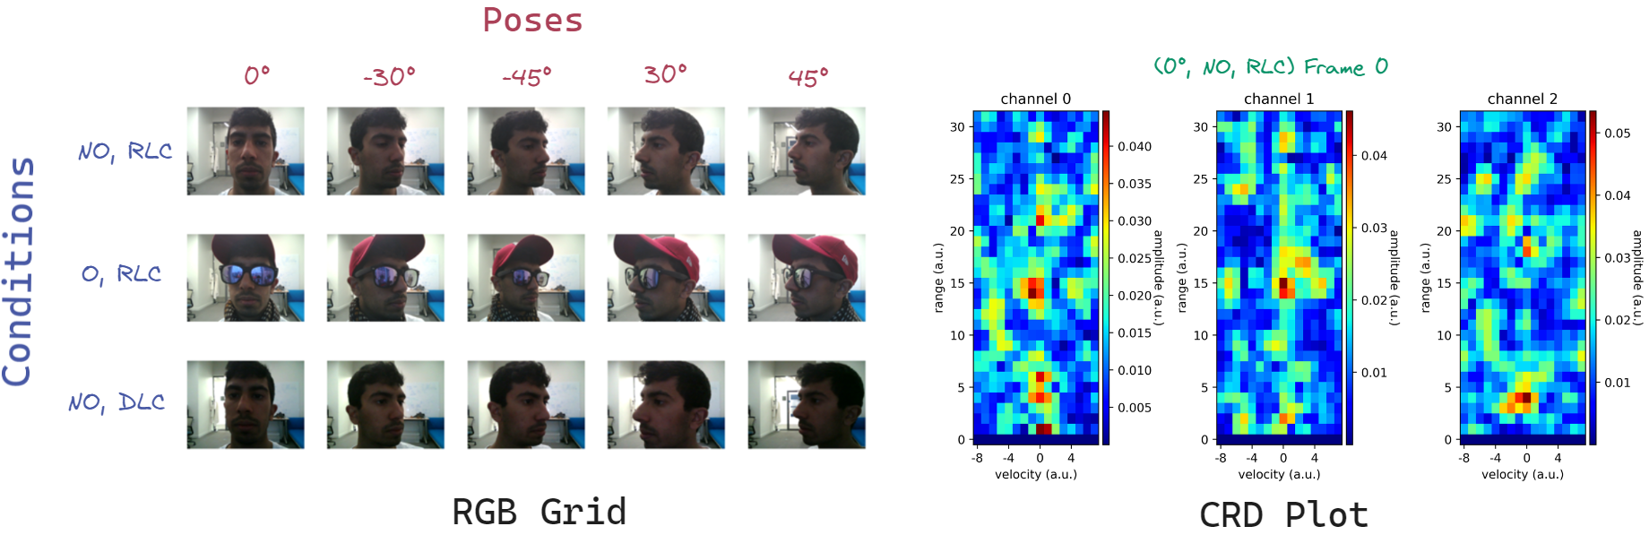
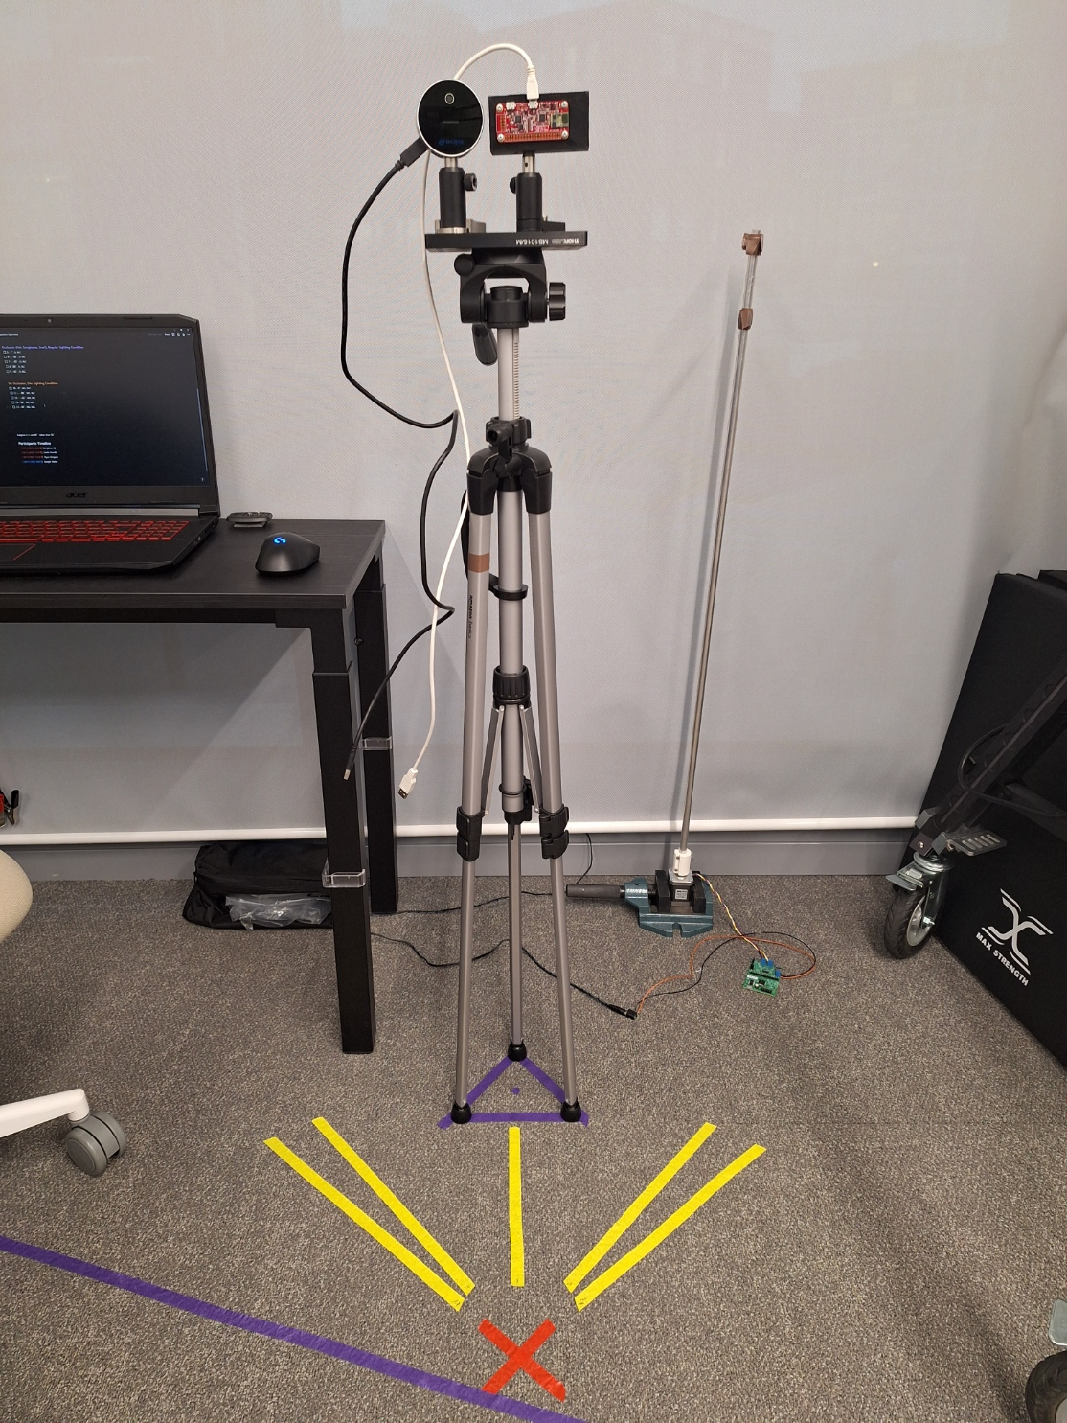
Data Acquisition
Intel Realsense RGB-D camera
Google’s Soli 60 GHz radar sensor

Slide 4
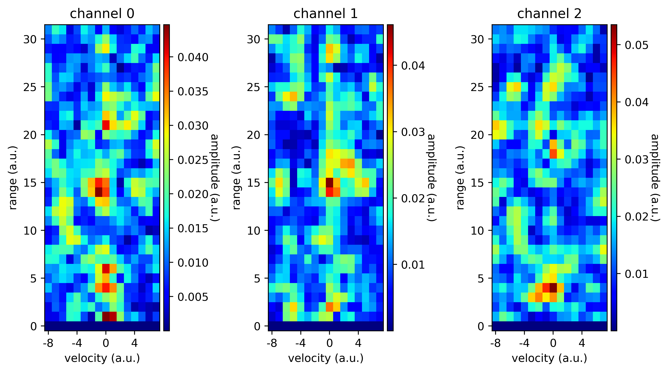
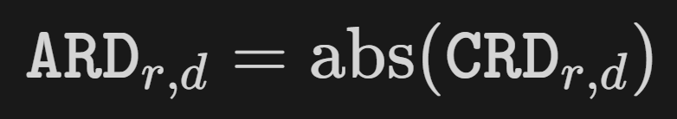
Data Preprocessing
Radar bursts received by the Soli undergo multiple FFTs
Raw signals discretised into Complex Range-Doppler (CRD) map
Magnitudes of each complex value are taken to derive an Absolute Range-Doppler (ARD) map
Data augmentations applied to both modalities through horizontal and vertical reflections

Slide 5



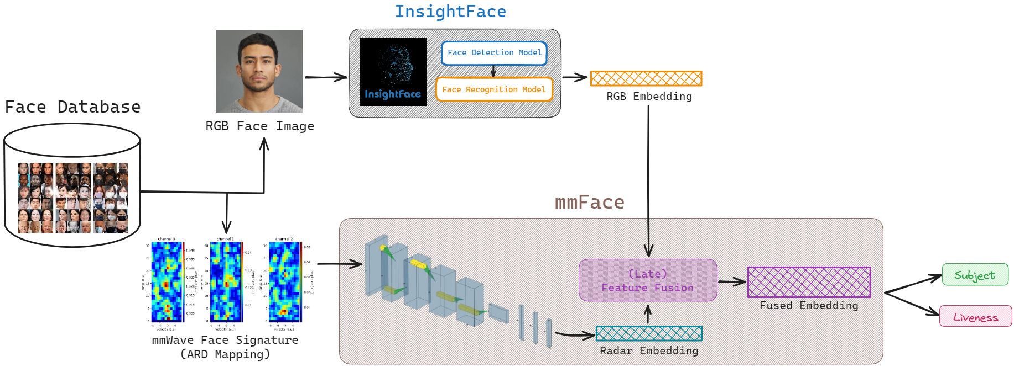
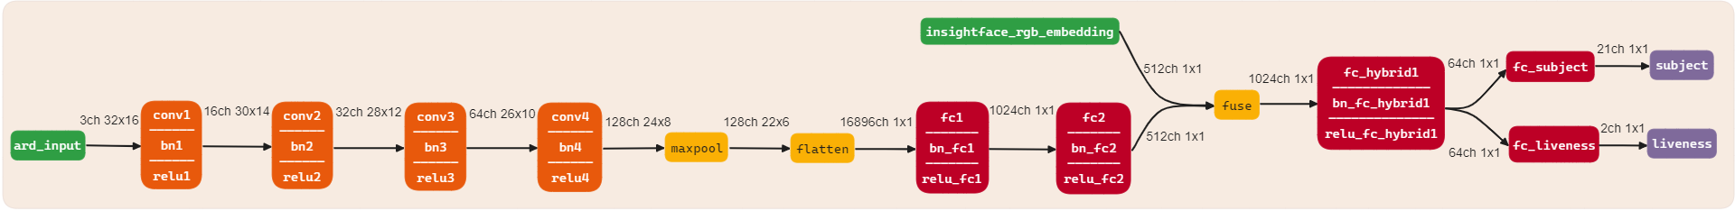
Model Architecture

Slide 6

EVALUATION

Slide 7
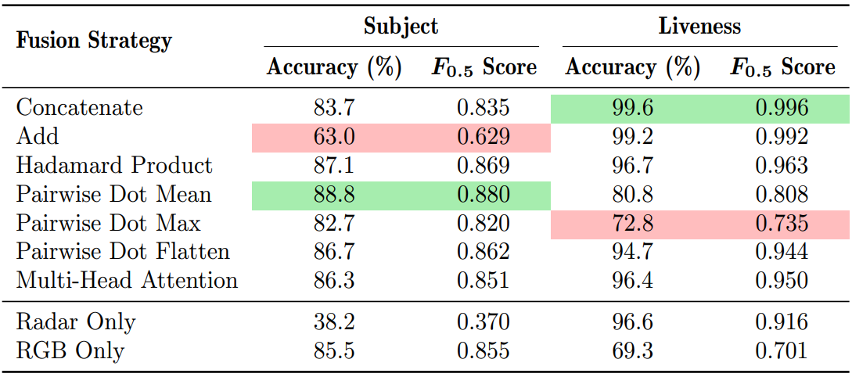
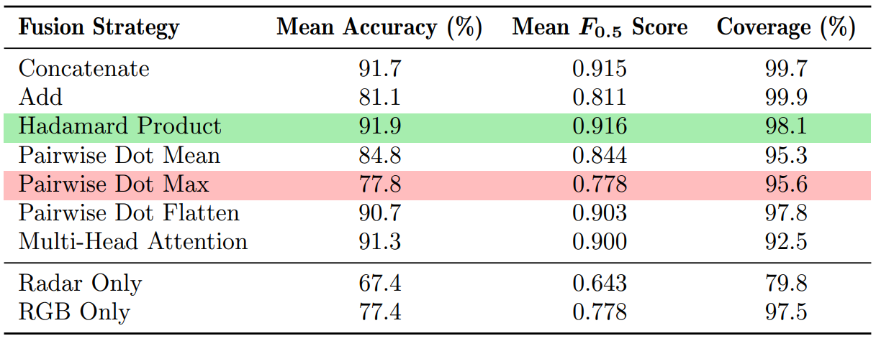
Zero-shot Classification Accuracy
Models assessed through zero-shot classification task against 8 reference embeddings (4 unseen subjects)
Best and worst performers highlighted in green and red
Concatenation emerges as best performer in liveness detection
Pairwise Dot Flatten best at identity recognition
Averaged metrics favour Hadamard Product strategy
Table 1: Subject and liveness accuracies and $F_{0.5}$ measures for all seven fusion strategies along with the individual modalities
Table 2: Averaged accuracies and $F_{0.5}$ scores for all models with equal weighting applied to both prediction types.

Slide 8
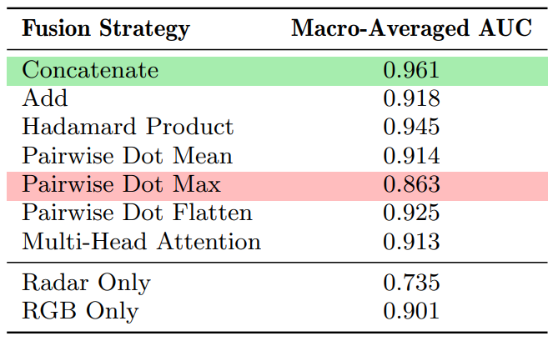
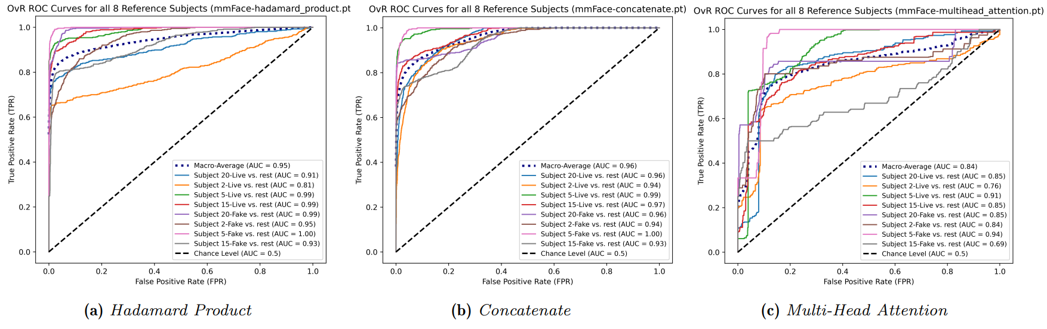
OvR ROC Curves and AUC

Slide 9
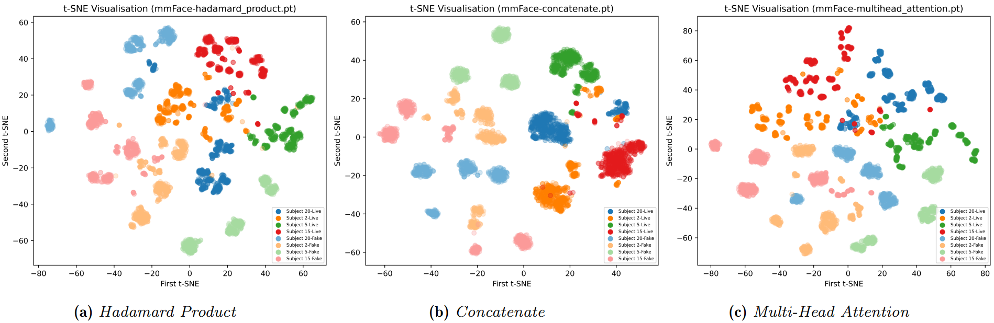

$t$-SNE Visualisations

Slide 10
Discussion of Results
Concatenation found to yield best-performing model overall
2nd highest in the aggregated general metrics
3rd highest under dim lighting only
Top ranking in occlusion-only scenarios
Hadamard Product fusion falls short in its classifying ability under different thresholds
Multi-Head Attention suffers from a low coverage rate
InsightFace RGB embeddings can discern real and fake photographs at a modest rate
The Soli radar sensor lacked precision for identity differentiation
Fusion models effectively use 3D information from the radar data to boost liveness detection

Slide 11

Achievements
Proposed a novel 3D face recognition model: mmFace
Distinguishes between unseen unique identities and verify their legitimacy
Gathered our own dataset featuring face scans of 21 participants under various conditions
Robust to environmental conditions and presence of face accessories
Counters 2D spoofing attacks and facial concealment using common items
Several fusion strategies analysed to identify concatenation as the most optimal across all conditions
Achieves 83.7% and 99.6% accuracy at predicting subject and liveness respectively, against a zero-shot classification task
Notes:
What did this project achieve?
Proposed a novel 3D face recognition model, mmFace, that can effectively distinguish between new unique identities as well as verify their legitimacy.
Gathered our own dataset featuring face scans of 21 participants under various conditions including: 5 facial poses, 2 lighting settings, and 2 occlusion scenarios.
The system is robust to environment conditions and facial poses.
It is also able to counter 2D spoofing attacks through printed face images on paper and facial concealment using common face accessories like hats, sunglasses and scarves
7 different feature fusion strategies were empirically investigated to find the most optimal method in blending the 2 modalities. Concatenation was found to be the best.
Achieves 83.7% acc at recognising subjects and 99.6% acc at detecting liveness against a zero-shot classification task.
Effectively demonstrating that unique identities are pushed to distinct regions in the high-D embedding space.

Slide 12

Future Work
Expand dataset size to 100 participants
Inconsistencies within the dim lighting condition should be mitigated through controlled lumen measurements
Diversifying the clothing apparel for more extreme cases of face concealment
A look into the effect of facial expressions
Leverage vision transformers employing a more rigorous self-attention mechanism
Additional fully connected layers for the Pairwise Dot Flatten strategy
Notes:
Our current model suffers from a certain number of limitations providing ample scope for future work:
Firstly, our dataset size is relatively small and should be expanded to 100 participants in future collection procedures.
This allows a bigger and more varied test set to really gauge the generalisability of our model to unseen faces.
The dim lighting experiment exposed subtle inconsistencies between face scans.
This was because collection procedure lacked strict control of the dimly lit environment. The experiment room allowed natural light that could not be fully blocked resulting in variations in captures taken at different times of the day.
Diversifying the clothing apparel to investigate more extreme cases of face concealment using ski masks or Halloween masks.
A look into the effect of facial expressions on the system.
With the bigger dataset, we can then leverage vision transformers that would employ a more rigorous self-attention mechanism. Our multi-head attention strategy did not take into account any positional encoding of the features.
Additional fully connected layers are needed for the Pairwise Dot Flatten strategy to compress the resulting 260 thousand-D feature vector in a more gradual process.

Slide 13
Thank you
Any Questions?

Slide 14
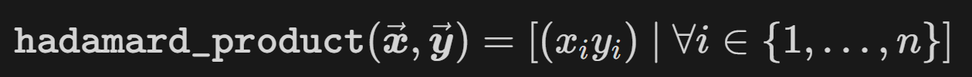
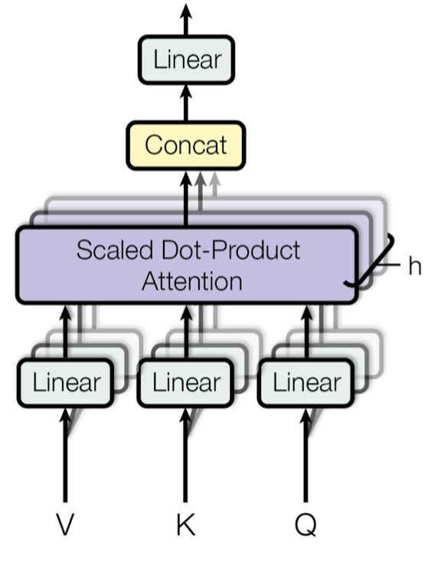
Feature-level Fusion Strategies
Concatenate
Add
Hadamard Product
Pairwise Dot Mean
Pairwise Dot Max
Pairwise Dot Mean
Multi-Head Attention

